Slide 1

House Bill 2001
Code Amendments Process
Reality Check
Presented by
Paul Conte
paul.t.conte@gmail.com
541.344.2552
TrustTheNeighbors.org
All slides © Copyright 2020 Paul Conte. All rights reserved

Slide 2
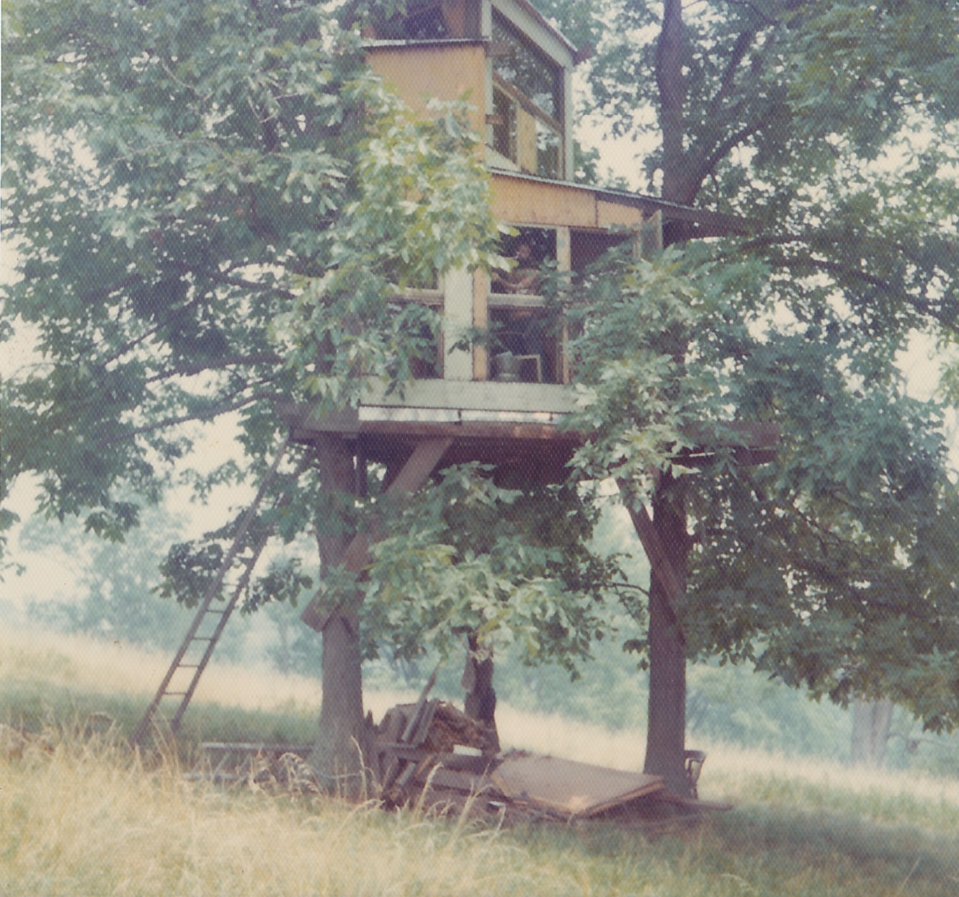
My “affordable home” in Kentucky for two years.
Title and Content Layout with List

Slide 3
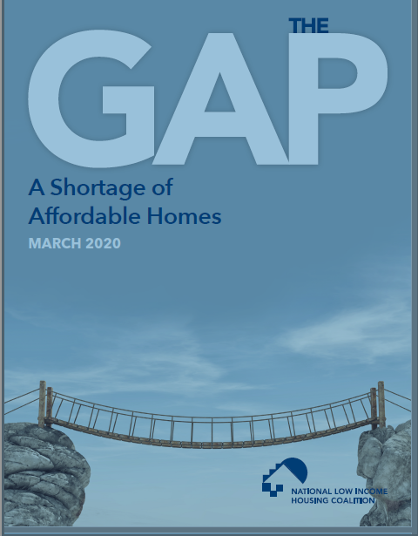
Let’s get serious about housing affordability.
-
National
Low-Income Housing Coalition
2020 Report
Read it! reports.nlihc.org/gap

Slide 4
NLIHC Report Major Points
  In addition to the unhoused population, almost all of the households that are "housing-cost-burdened" are renters.
  Almost all of the households that are "housing-cost-burdened" are low-income households.
  The disproportionate number of non-white households that are "housing-cost-burdened" is due primarily to their lower income and wealth (including home ownership), for which multiple historical factors were a substantial cause. Secondarily, "availability" of affordable housing to non-white households is limited in some cases by illegal discrimination.
  "The housing needs of middle-income renters are largely met."
  "The filtering ["trickle-down"] process fails to produce a sufficient supply of rental homes inexpensive enough for the lowest-income renters to afford.
  "Zoning reforms alone will not sufficiently improve the ability of extremely low-income renters to afford rents."
  "A private housing market driven by economic incentives will continually fail to meet the needs of extremely low-income households."
  "The private market cannot and will not, on its own, build and operate homes extremely low-income families can afford."

Slide 5

Takeaways from this presentation
Insist on getting information from sources that challenge what you’ve heard so far from advocates who want to impose “blanket” upzoning on all neighborhoods and then let private, profit-oriented investors & developers decide the type and cost of what housing gets built.
Understand that upzoning and increasing allowable density without protecting vulnerable renters will worsen – not improve – affordability.
Understand that the private market cannot and will not produce affordable “middle housing” no matter what code changes are adopted. No way, no how.

Slide 6
Recommendations to City Council
Three important recommendations that the Review Panel should make:
1. “Ensure HB 2001 code amendments will not increase displacement and/or ‘gentrification’ in neighborhoods of color or that are comprised of predominantly low-income households.”
2. Prohibit demolition of any dwelling that’s affordable to households with annual income of 80% of Area Median Income unless at least one replacement dwelling meets that same affordability criteria.
3. “Require all revelopment that increases density above the current allowable maximum in single-family zone(s), including R-1 Low-Density Residential Zone, to provide at least 51% of dwellings affordable to households with annual income of 80% of Area Median Income.”

Slide 7

This presentation provides credible research and expert opinions to support all assertions.
Annotated HB 2001 References
trusttheneighbors.files.wordpress.com/2019/12/hb-2001annotatedlistofrefrences7dec2019.pdf
Comprehensive resource on HB 2001:
trusttheneighbors.org/hb2001
The Review Panel should insist other presenters provide complete, credible references.
How about a debate? (I’d be available.)

Slide 8

First: Understand the scope of the problem!
Only very low-income households lack adequate supply of affordable housing
From the latest Census data for Eugene …
  There is a surplus of affordable housing for all households with income over $25,000.
  There is a large deficit of affordable housing for households with incomes below $25,000 (“Very Low Income” – “VLI”)
90% of these households have incomes below $15,000
(“Extremely Low Income” – “ELI”)
FACT: Market rate housing cannot produce housing that VLI and ELI households can afford to purchase or rent. (National Low-Income Housing Coalition research)
FACT: Subsidized housing, specifically apartments with access to good public transportation, is the only viable solution to the real “housing crisis” in Eugene.
FACT: Eugene could use the Multiple-Unit Property Tax Exemption (MUPTE) for subsidized apartments on the W. 6th & 7th Aves. EmX route.

Slide 9
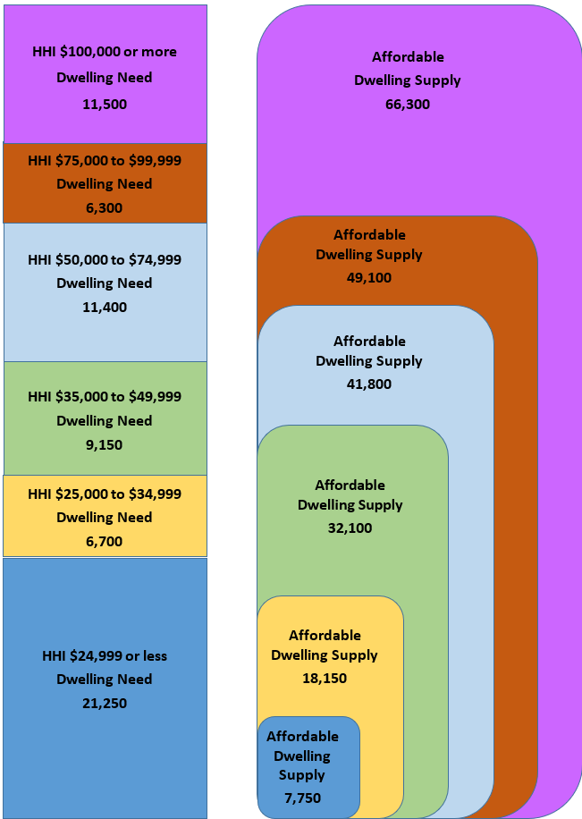
Supply of affordable housing in Eugene
Compare the “need” of an income category (on the left) with the “cumulative supply” of affordable housing (on the right); e.g., (green) for HHI $35,000 to $49,999, need is 9,150 & “cumulative supply” is 32,100.
_______
The ONLY deficit is “blue” – less than $25,000 income.*
_______
* About 90% of the shortfall of affordable dwelling supply is in a subcategory of less than $15,000 income.

Slide 10
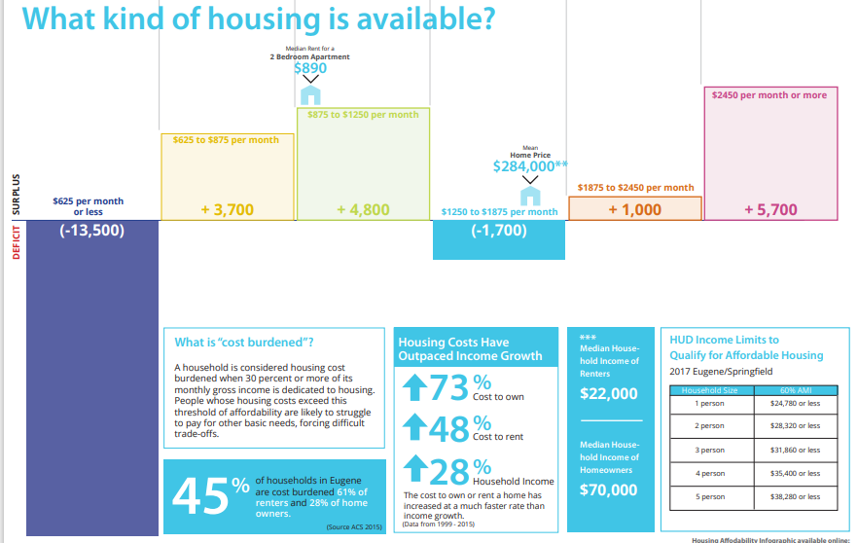
City of Eugene version of “availability

Slide 11
Caveat: “Affordable” vs. “Available”
While there may be “affordable” housing
supply, it may not be “available” to some
proportion of households.
Some lower-income households will rent
dwellings that are above the “affordable”
amount for the household. This lessens the
“available” supply for higher income
households, creating a net shortage/cost
increase in higher income categories.

Slide 12
“Trickle Down” myth vs. “Trickle Up” reality
“Trickle Down” is a myth! Building more dwellings that are affordable
only to higher-income households does not lower the cost of dwellings
that are affordable to lower-income households.
Unlike corn or gasoline, the housing market is “stratified” and
adding “supply” of dwellings in the high-cost range does not increase
“supply” (and thus lower cost) in the low-cost range.
“Trickle Up” does lower the cost of housing for multiple household
income categories. Building more dwellings that are affordable to
lower-income does lower the cost of dwellings that are affordable to
higher household income categories.
Supplying additional lower-income households removes them
from the households competing for higher-cost dwellings.
So “demand” is reduced, which lowers costs.
DON’T BE FOOLED BY BOGUS “LAW OF SUPPLY AND DEMAND” CLAIMS!

Slide 13
Eugene zoning isn’t racially exclusionary
A greater proportion of non-white households are housing-cost
burdened for a simple reason: A greater proportion of non
-white households have lower household incomes.
The Census data for Eugene makes clear that household income and housing costs are the main factors in where households live. Lower income households are predominantly renters, and apartments provide most of the supply of lower cost housing.
So-called “Middle Housing” is in no way inherently “inclusionary,” nor does allowing redevelopment with “Middle Housing” remediate historical racial injustice in any way –
unless the rent is affordable to lower-income households
DON’T BE MISLED BY “WOKE-WASHING” MARKET-RATE UPZONING!

Slide 14
Upzoning land increases price/rent and causes displacement
HB 2001 upzones land without restrictions or affordable housing requirements
The land becomes more valuable and thus, more expensive.
In upzoned, single-family neighborhoods of color and poorer
neighborhoods, the land is more valuable, but the homes are not.
In such areas that are close to amenities, investors buy lots that have low improvement (home) value, but high investment return potential for redevelopment with multiple, mid- to high-price/rent condos and rentals.
  This selective redevelopment potential leads to increased rents for
  the lower range of rentals and increased purchase price for lower-
  cost houses, which forces lower-income households to move.
SUPPORTING FACTS: NE Portland and major research in Chicago.
  https://youtu.be/sFwSk6wQFoU Portland Commissioner Baugh

Slide 15
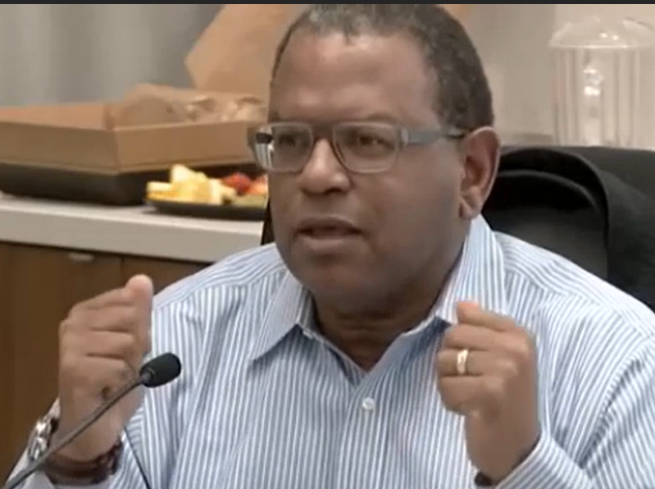
The Reality: Displacement of Non-whites
https://youtu.be/M_Wwk5cizug
“RIP is agreeing to displace minorities as part of a policy for creation of additional [housing] opportunities. … We’ve made it [a future] era of displacement of minorities in the single-family homes. ....”
Commissioner Andre Baugh, who led four Portland Planning & Sustainability Commissioners in opposing the Residential Infill Project (“RIP”), Portland’s version of HB 2001.

Slide 16
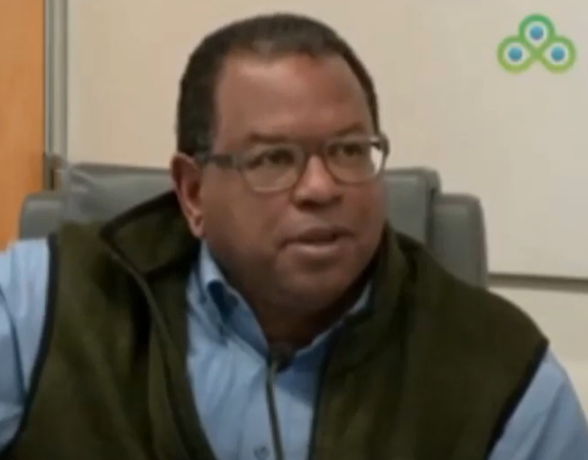
The Reality: Displacement of Non-whites
“Institutional Racism is defined as ‘racial discrimination that has been established as a normal behavior of society.’ This [upzoning] is becoming normal behavior for us to say ‘We’re OK with displacement …’.”
More at: https://youtu.be/sFwSk6wQFoU
https://youtu.be/WB46fJW-rk0

Slide 17
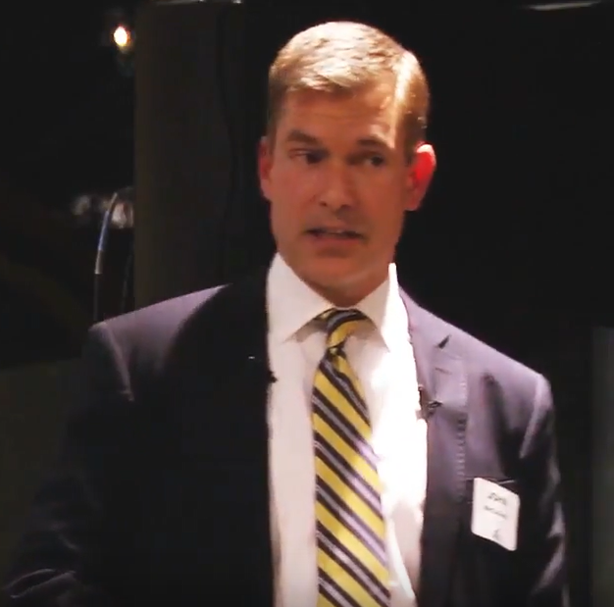
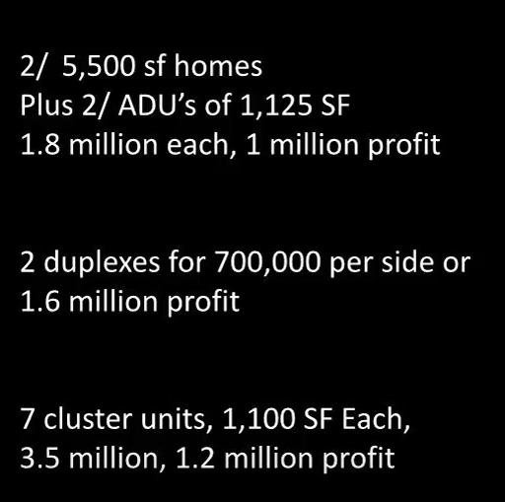
The Reality: A Developer’s Analysis
“I’m a developer, and I know exactly how to make the most money by tearing down your neighborhood and rebuilding.” https://youtu.be/O3LnoZTxx3A

Slide 18
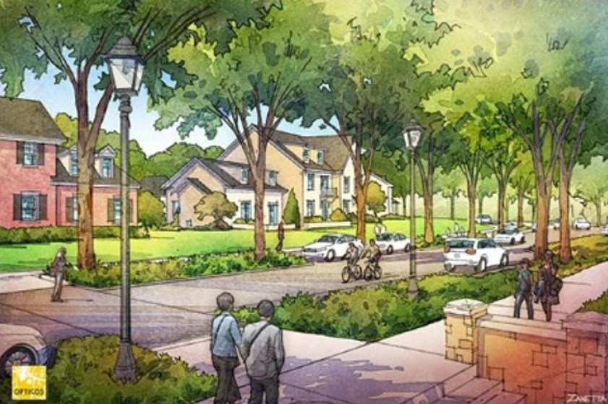
The nostalgic sales pitch for “middle housing”
Title and Content Layout with List

Slide 19
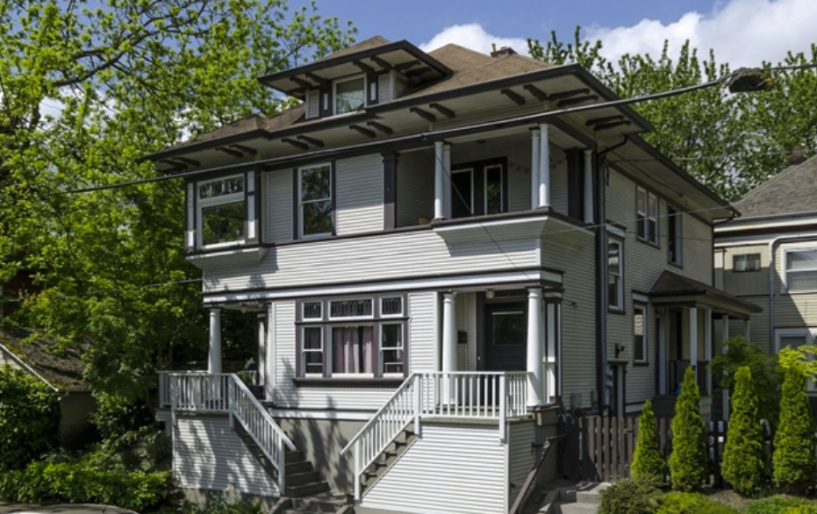
A supposed “middle housing” fourplex that would result from HB 2001

Slide 20
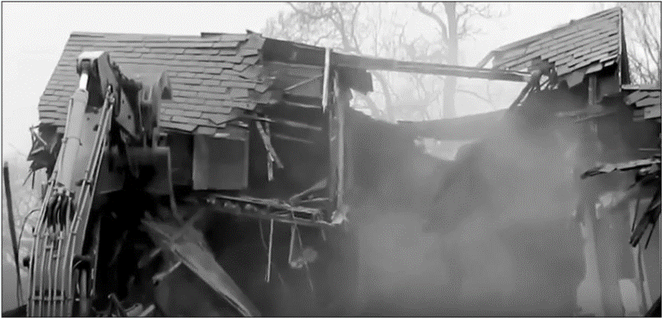
The Reality: Scenes from Portland
https://youtu.be/Uqo-M8eFNXo

Slide 21
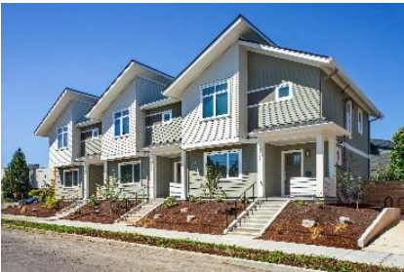
Replaced with Private Market-Rate
"Middle Housing“
Think about how insulting this is to the low-income families that have to move.
$400,000
Condos
are a bad joke
to households with less than $30,000 annual income.

Slide 22

Burn this fact into your brain
HB 2001 upzoning of single-family
neighborhoods without protecting against
displacement and gentrification
is racially and economically
inequitable and elitist.

Slide 23

Envision Eugene “Livability” Pillar
No increase in density unless in accordance with the goals and recommendations of the Infill Compatibility Standards Task Team – i.e.:
  “preventing negative impacts and promoting positive impacts
  of residential infill development on neighborhoods.”

Slide 24
Some final words – How can we help?
The true “housing crisis” in Eugene, Oregon and the nation is among low-income households.
The “market” cannot deliver scalable solutions.
The solution is more funding for subsidized, mostly multifamily housing.
The immediate opportunity in Eugene is to provide “Multiple-Unit Property Tax Exemptions” (MUPTE) for affordable housing development along the W. 6th and 7th EmX corridors.
  Engage the bordering neighborhoods: Jefferson Westside Neighbors and Whiteaker Community Council
  Update the refinement plans for the target areas
  This would provide not only housing, but the public transportation that is essential for low-income households.

Slide 25
Thank you!
Paul Conte paul.t.conte@gmail.com
All slides © Copyright 2019 Paul Conte. All rights reserved

Slide 26

Beau says: “Learn more from the following slides and resource links.”

Slide 27

Questions?

