Slide 1
House Bill 2001
The Complete Survival Guide for Single-Family Neighborhoods
Presented by
Paul Conte
paul.t.conte@gmail.com
541.344.2552
TrustTheNeighbors.org
All slides © Copyright 2019 Paul Conte. All rights reserved

Slide 2
Introduction and Logistics
  Thank You! Scott Landfield for making Tsunami Books available for this seminar.
  Please place cell phones on “stun”
  Restrooms are …
  Feel free to leave at any time
  A copy of the presentation slides will be posted at
  TrustTheNeighbors.org/seminar
  Please support Community Supported Shelters
    Leave a donation here or directly to CSS.
    https://communitysupportedshelters.org/

Slide 3

Please help provide safe shelter in our neighborhoods

Slide 4
What you can expect after tonight
  You will understand the upzoning provisions
  dictated by House Bill 2001.
  You will have learned about reliable evidence and critical analyses of HB 2001’s potential impacts.
  You will understand how upzoning could harm residents in some areas of Eugene’s single-family neighborhoods.
  You will know where to find additional resources to better understand the potential impacts of HB 2001.
  You will have learned about multiple actions you can take to ensure your neighborhood area’s livability.

Slide 5
In a “nutshell”
  HB 2001 forces Eugene to upzone large areas to allow multiple dwellings, up to fourplexes, on single-family lots.
  HB 2001 will not improve affordability of housing for “housing cost burdened” households.
  HB 2001 will increase rent and housing prices in some areas of existing lower-cost housing.
  HB 2001 may allow serious loss of privacy, looming structures, congestion, etc. in areas.
  Eugene City Council can either worsen or mitigate the negative impacts of HB 2001.

Slide 6
HB 2001
Miracle or Monster?

Slide 7
Why are we here?
  HB 2001 imposes forced upzoning of all single-family neighborhoods in Eugene.
  The upzoning will allow up to four dwellings on a lot.
  Proponents of HB 2001 misleadingly describe this as
  “re-legalizing so-called ‘missing middle housing’.”
  Advocates of “missing middle housing” rely on nostalgic images of the kinds of plexes that were typical decades ago in transition areas between low-scale commercial and single-family neighborhoods bordering streetcar lines.
  Here’s what forced upzoning causes in today’s cities:
    Portland did a comparable upzoning in the past couple of years.
    Eugene upzoned an R-2 neighborhood in the 1980s and 1990s.

Slide 8
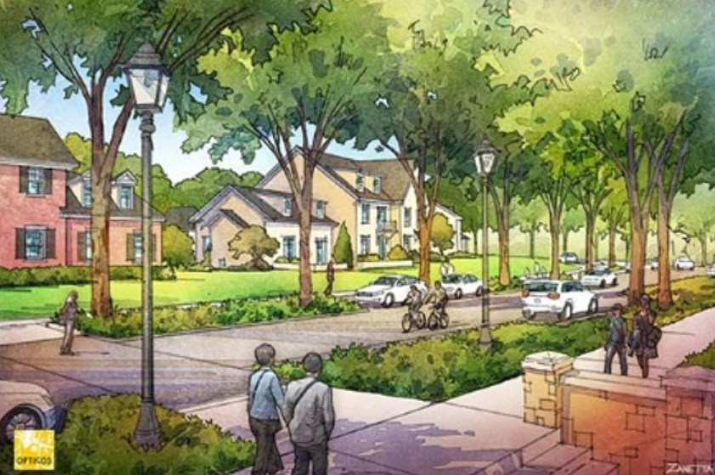
The nostalgic sales pitch for “middle housing”
Title and Content Layout with List

Slide 9
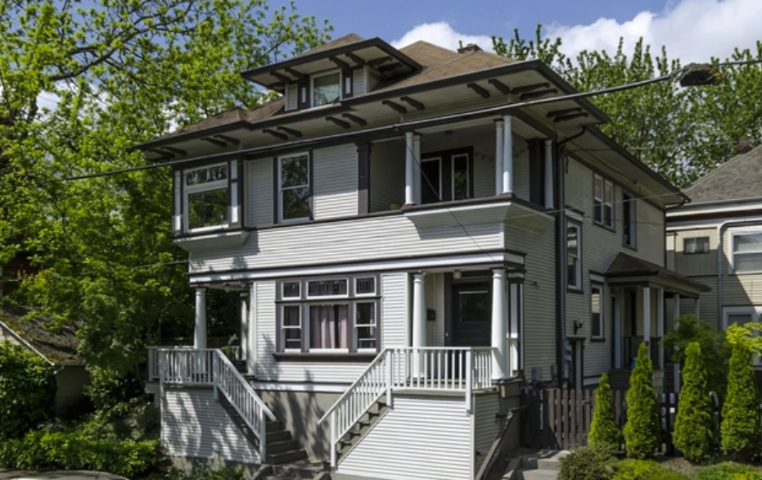
A supposed “middle housing” fourplex that would result from HB 2001

Slide 10
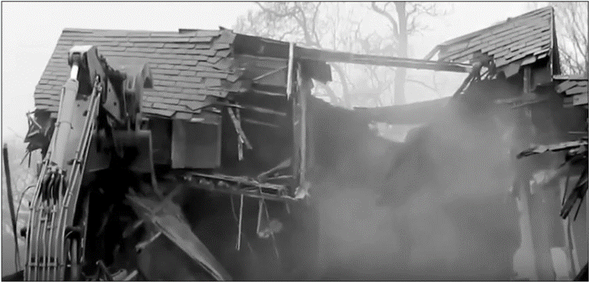
The Reality: Scenes from Portland
https://youtu.be/Uqo-M8eFNXo

Slide 11


Alarmist! This isn’t going to happen in Eugene!
Alfred E. Neuman
Meher Baba

Slide 12
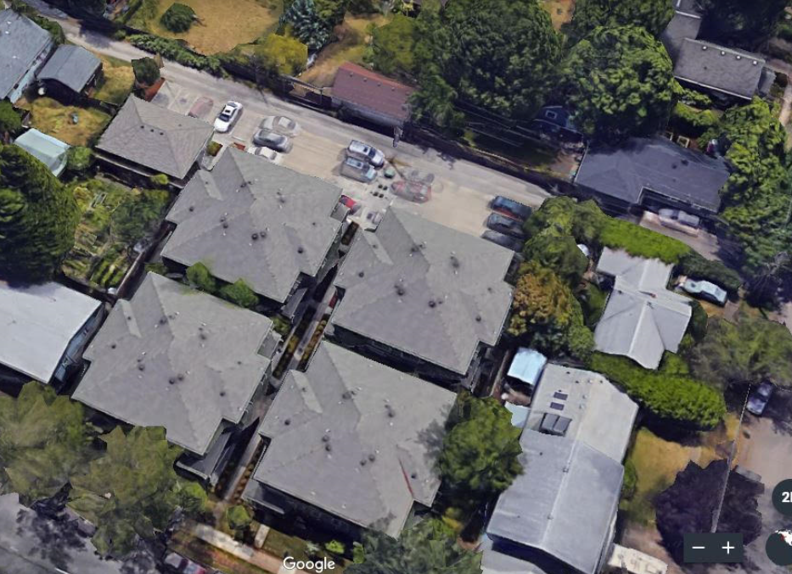
The reality in Eugene: R-2 upzoning for 4-plexes
Title and Content Layout with List
West 11th Ave.

Slide 13
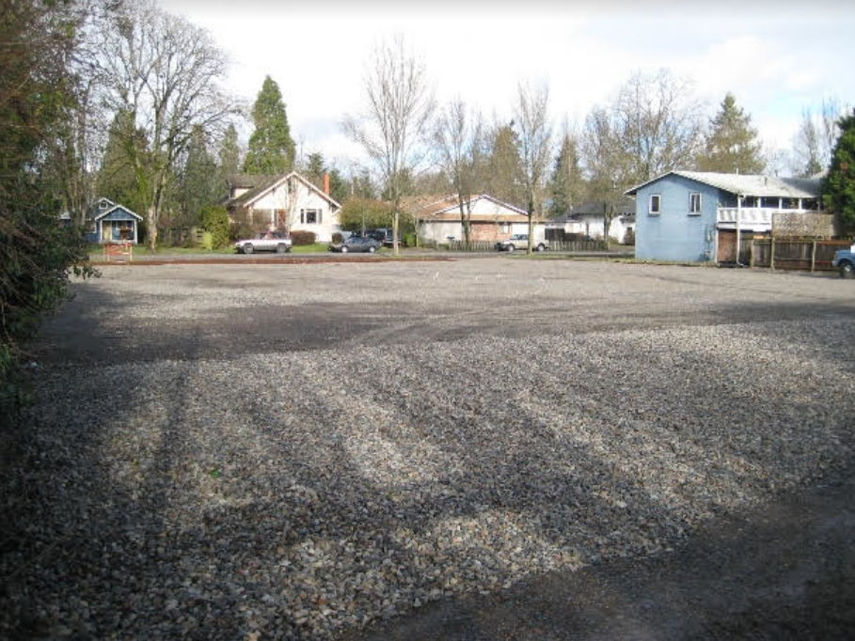
Affordable housing … Scraped off two lots
Title and Content Layout with List
West 11th Ave.

Slide 14
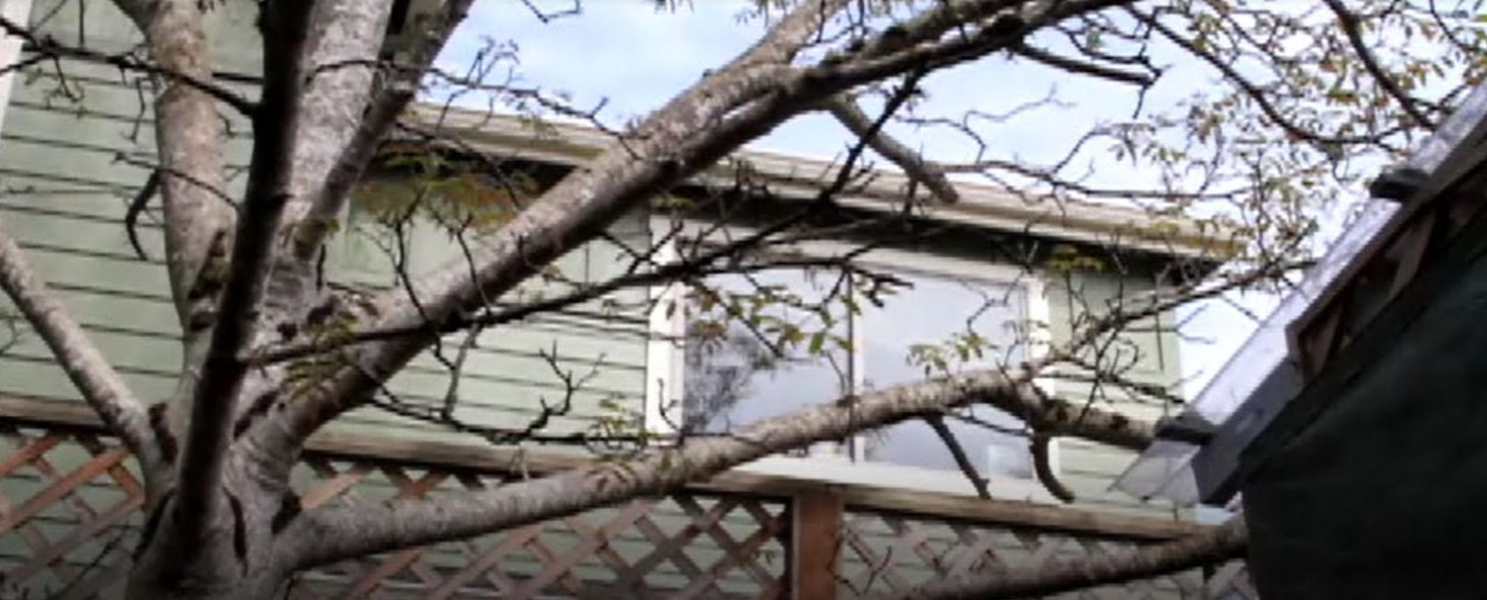
The “charm” viewed from an adjacent backyard
Title and Content Layout with List
Van Buren St.
HB 2001 is only about “choice” … for real estate investors.
HB 2001 affords adjacent homeowners and residents no choice, at all.

Slide 15

The Reality: Impacts on decent residents
https://trusttheneighbors.files.wordpress.com/2019/12/peoplenotbuildingsvideo.mp4 Video starts at 5:45

Slide 16
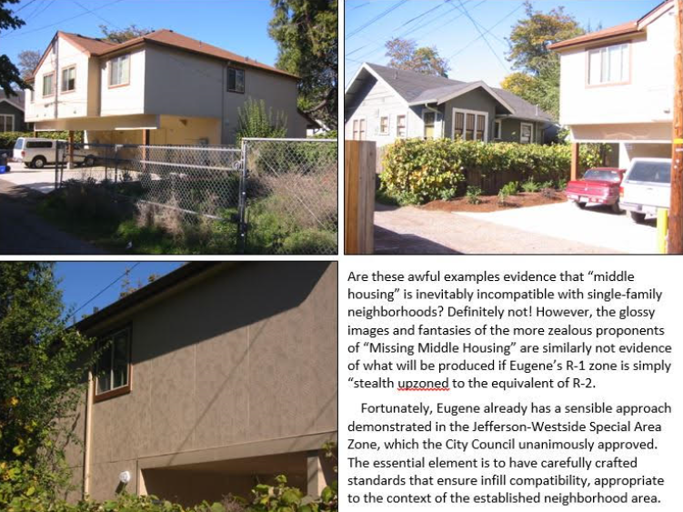
A charming R-2 “middle-housing” triplex in Eugene
Title and Content Layout with List
West 11th Alley.
In rear yard of house on W. 11^{th.}
Four dwellings jammed on a single-family lot.
Shuts out morning sunlight
Eliminates privacy
Increased noise and dust from cars on the alley
Mid-block traffic increases pedestrian risk
Worsens storm runoff
The wall that faces the
small house’s dining room

Slide 17
The history of “R-2” upzoning in Eugene
Title and Content Layout with List
1948: R-2 Two-Family Residential District. Duplexes and ADUs allowed. Apartments allowed abutting a commercial district.
1962: R-2 Limited Multi-Family District. Apartments allowed. Max density 14.5 dwelling units per net acre (du/na).
1982: R-2 Density increased to 19.3 du/na.
2000: R-2 Medium-Density Residential District: 28 du/na.
The 4-plexes & triplex examples created under R-2 zoning.
2009: R-2 max height over 40' & interior setbacks only 5'.
2010: Jefferson-Westside Special Area Zone ended this abuse.

Slide 18
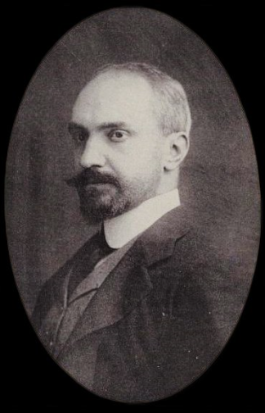
“Those who cannot remember the past are condemned to repeat it.”
-- George Santayana

Slide 19
Eugene City Council may repeat the R-2 travesty
Title and Content Layout with List
Local individuals and organizations are working hard to replace
R-1 zoning criteria with standards like the R-2 zone.
Much higher density & much more intensive development.
WECAN and Better Housing Together (BHT) supported the most extreme provisions of HB 2001 (e.g., Eugene can no longer require that an owner reside on the same property as an ADU).
If you don’t want to see the kinds of incompatible development
in your R-1 single-family neighborhood that were, and still are, allowed under the R-2 zone …
Get engaged!

Slide 20

Do we have your attention now?

Slide 21
Zoning provisions in HB 2001
Details from the adopted bill, available at:
https://olis.leg.state.or.us/liz/2019R1/Downloads/MeasureDocument/HB2001/Enrolled
And at TrustTheNeighbors.org

Slide 22
Impactful HB 2001 Dictates – by June 30, 2022
Eugene must amend its zoning code for the following zones that have been largely built-out with single-family, detached houses plus some accessory dwelling units (ADUs) and duplexes.
  R-1 Low-Density Residential
  Special Area Zones: Blair Blvd., Chambers, Jefferson-Westside, Royal, Whiteaker
Areas with restrictive CC&Rs (Covenants, Conditions & Restrictions)
are exempt.
Amended code must allow:
  A duplex on every lot, no matter how small or lacking code-compliant vehicle access
  Triplexes and fourplexes (in up-down or side-by-side form), as well as “cottage clusters”
  A second detached dwelling (with no owner-occupancy)
  HB 2001 appears to allow the City to adopt some siting and design criteria for all the dictated housing types, except any code that would prohibit a duplex while allowing a single-family dwelling.

Slide 23
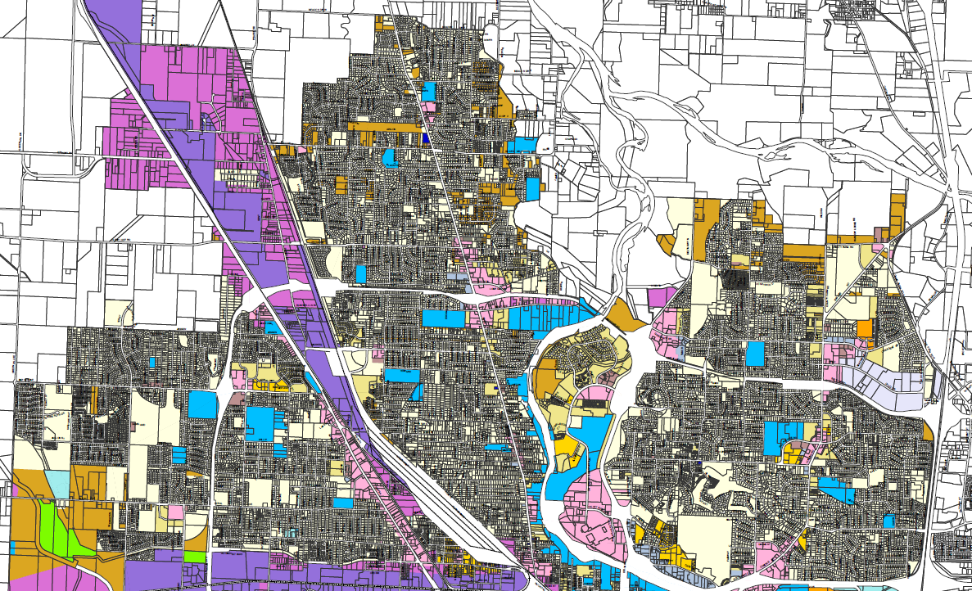
North Eugene Zoning

Slide 24
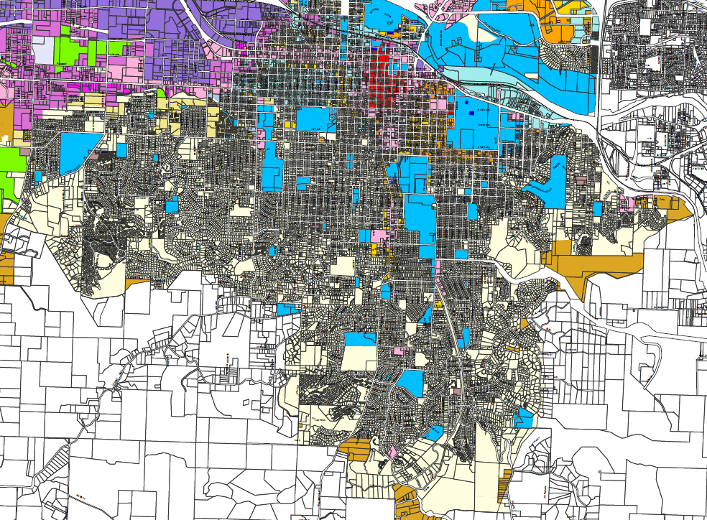
South Eugene Zoning

Slide 25
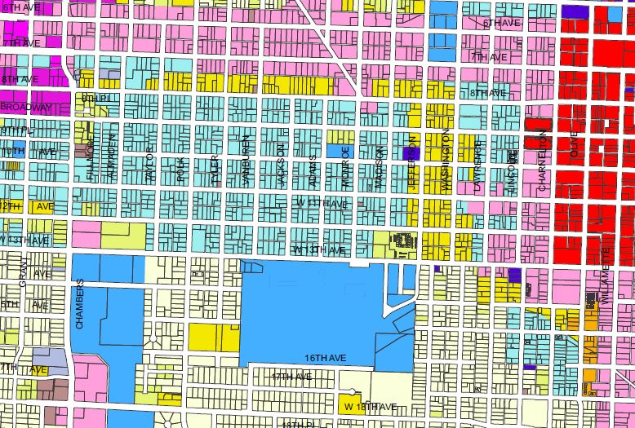
JWN Zoning
Jefferson-
Westside
SAZ
Chambers
SAZ
Jefferson-
Westside
SAZ
R-1
R-1

Slide 26
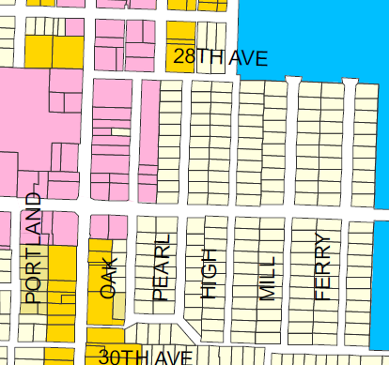
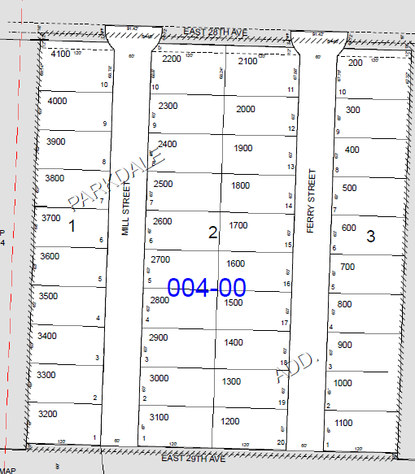
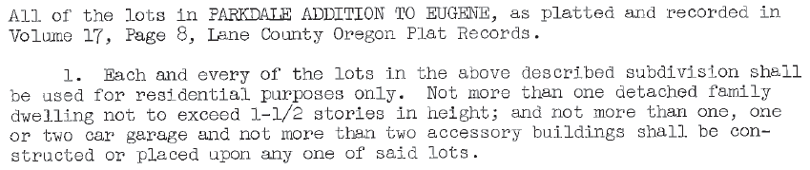
CC&Rs example – “Parkdale”

Slide 27
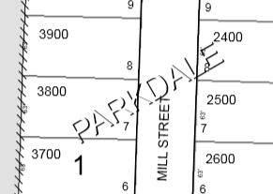
How to find CC&Rs
  Download Tax map from: https://ormap.net/
  Select “Map Viewer” and enter a street address.
  When the area map is displayed, double-click the map number to select it. Click the “>” and then click the map number from the displayed list.
  Download the PDF file and examine
  the map for subdivision name(s),
  such as PARKDALE.
  Lookup the subdivision name at: https://www.westerntitle.com/ccr
  A plat includes a map and, optionally CC&Rs. Some plats reference a separate document, filed with Lane County.

Slide 28

Questions about
HB 2001 provisions?

Slide 29
Impacts of HB 2001
An analysis based on evidence and research
All assertions are based on data, research and credible expert opinions that can be viewed in the following document:
Annotated HB 2001 References
at TrustTheNeighbors.org

Slide 30

HB 2001 Reality Check
HB 2001 upzones land for more intensive residential development.
HB 2001 does not create any new housing at all.
The real estate market – investors & developers – will determine:
  How many new dwellings are built
  The type and design of dwellings
  The purchase price or rent of new dwellings
  The location of new dwellings
  HB 2001 doesn’t have any direct or indirect provision
  that requires or encourages investors and developers
  to create housing that is affordable to households
  that are “housing-cost burdened.”

Slide 31
Only very low-income households lack adequate supply of affordable housing
From the latest Census data for Eugene …
  There is a surplus of affordable housing for all households with income over $25,000.
  There is a large deficit of affordable housing for households with incomes below $25,000 (“Very Low Income” – “VLI”)
90% of these households have incomes below $15,000
(“Extremely Low Income” – “ELI”)
FACT: Market rate housing cannot produce housing that VLI and ELI households can afford to purchase or rent. (National Low Income Housing Coalition research)
FACT: Subsidized housing, specifically apartments with access to good public transportation, is the only viable solution to the real “housing crisis” in Eugene.
FACT: Eugene could use the Multiple-Unit Property Tax Exemption (MUPTE) for subsidized apartments on the W. 6th & 7th Aves. EmX route.

Slide 32
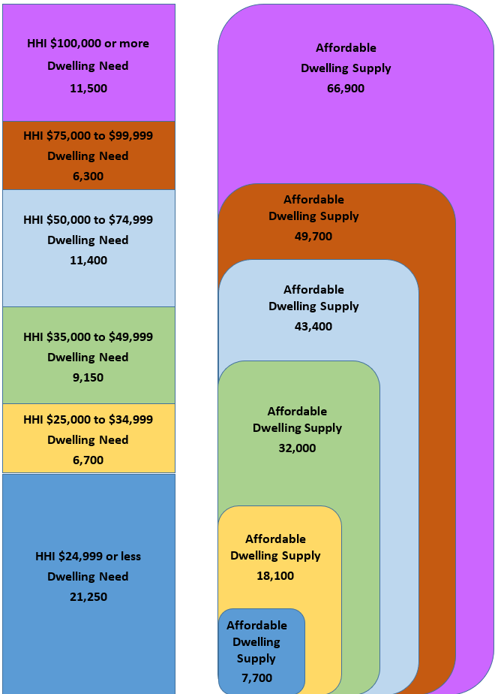
Supply of affordable housing
Compare the height of an income category with the aggregate height of affordable housing;
e.g., “green” to “green.”
_______
The ONLY deficit is “blue,”
less than $25,000 income.
_______
About 90% of the shortfall of affordable dwelling supply
is in a subcategory of less than $15,000 income.

Slide 33
Increasing the supply of market-rate housing will not lower the price/rent for housing that VLI and ELI households can afford.
A Simple Fact

Slide 34
There is no “trickle-down” benefit
HB 2001 upzones land and leaves the price/rent of housing that is built up to the market.
The market won’t support “affordable housing” for VLI & ELI households.
  “I also agree that filtering does not reach the lowest rungs of the income distribution. That is clear.” – Josh Lehner Oregon Office of Economic Analysis
Research & local Eugene developments show: The market will produce mid- to high-cost housing for multi-dwelling condos and rentals.
Research: The housing market is location-dependent and segmented; more supply creates downward pressure only on adjacent ranges.
Adding supply of mid- to high-price dwellings will not lower
the rental rates for ELI and VLI households.
In contrast, under conditions where all the deficit is in the VLI and ELI categories, adding supply (subsidized housing) in these categories has a “trickle-up” effect. (Because households that have been forced to “buy up” move out of the market for more expensive housing.)

Slide 35
Illustrative redevelopment proformas
Tentative Eugene financial proformas in R-1 Zone
  Area Median Income (household): Approx. $45,000
9,300 s.f. lot with single-family home @ $250,000
Add 1,000 s.f. units (total of 3 units in both cases)
Case 1 – Add 2 units (duplex or townhouse)
  Price per unit: $277,875 (800 s.f. & Alt. factors: $210,134)
  Minimum monthly rent: $1,654 ($1,250)
  Affordable to income at least: $74,160 ($58,032)
Case 2 – Demolish and build triplex or townhouse
  Price per unit: $368,750
  Minimum monthly rent: $2,194
  Affordable to income at least: $95,797

Slide 36

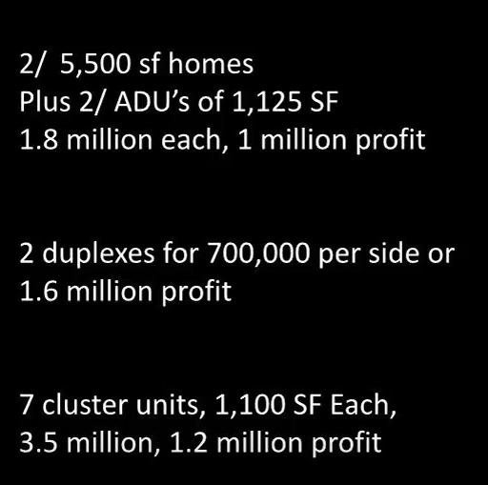
The Reality: A Developer’s Analysis
https://youtu.be/O3LnoZTxx3A

Slide 37
Upzoning land increases price/rent and causes displacement
HB 2001 upzones land without restrictions or affordable housing requirements
The land becomes more valuable and thus, more expensive.
In upzoned, single-family neighborhoods of color and poorer
neighborhoods, the land is more valuable, but the homes are not.
In such areas that are close to amenities, investors buy lots that have low improvement (home) value, but high investment return potential for redevelopment with multiple, mid- to high-price/rent condos and rentals.
  This selective redevelopment potential leads to increased rents for
  lower range of rentals and increased purchase price for lower-
  cost houses, which forces lower-income households to move.
SUPPORTING FACTS: NE Portland and major research in Chicago.
  https://youtu.be/sFwSk6wQFoU Portland Commissioner Baugh

Slide 38

Who benefits from HB 2001?
HB 2001 benefits “commodity” real
estate investors
HB 2001 does not benefit households
that are “housing cost burdened”

Slide 39

Burn this fact into your brain
HB 2001 upzoning is
racially and economically
inequitable and elitist.

Slide 40

Debunking the false narratives

Slide 41
Eugene’s R-1 Zone is not “exclusionary”
No structural elements that exclude buyers or renters based on race or economics.
Eugene has large areas of R-1 zoning with relatively low-price housing.
  The #1 “exclusionary” factor in Eugene is private “CC&Rs” – Covenants, Conditions & Restrictions” that are recorded when land is platted into individual lots.
  Many CC&Rs prohibit more than one dwelling on a lot.
  Such lots are exempt from HB 2001 dictates.
Who is protected: Julie Fahey – the Eugene State Representative who sponsored HB 2001. Jennifer Yeh, a Eugene City Councilor pushing for upzoning.

Slide 42
Opponents of HB 2001 are not “NIMBYs”
Most resident single-family homeowners, as well as renters, care about their neighborhood and are welcoming to diverse households and housing types.
  Referring to one’s neighbors as “NIMBYs” simply shows that a person both lacks respect for his or her neighbors and has no sound evidence or arguments.
  The Jefferson-Westside Special Area Zone demonstrates how a neighborhood can handle higher density, a variety of housing types and maintain a high degree of livability. (That may be a later seminar.)

Slide 43
Upzoning is not just “more choices.”
  HB 2001 provides investors a lot more choices, but it tramples on the choices that many homeowners made when they purchased their homes in an area that was developed mainly as single-family homes and authentic ADUs.
  The Oregon Legislators rammed HB 2001 through without any credible engagement of homeowners or local elected officials.
  Why? Because they didn’t want citizens to have a choice.
  Most importantly – It is unethical to create “choice” for higher-income households by forced, blanket upzoning of neighborhoods of color and poorer neighborhoods that will cause displacement of lower-income residents.

Slide 44

What could possibly go wrong with HB 2001?

Slide 45
A partial list of HB 2001 negative impacts
Already touched on in this presentation:
Degrades the livability and stability of neighborhoods
Increases housing cost for low-income households
Displaces residents in neighborhoods of color and poorer neighborhoods
Additional harmful outcomes:
Investment funds replace local home owners
Throws local infrastructure and services into chaos
Worsens climate change
Impedes government investment in public mass transit
Increases sprawl to Junction City, Creswell and other towns

Slide 46
Investment funds replace local residents as the owners of homes in formerly single-family neighborhoods
Healthy neighborhoods depend on the right mix and balance of housing types and ownership.
  Investors – including commodity real estate funds, Zillow, Trulia, Expedia, Travelocity, etc. are making huge purchases of single-family properties for both rental and AirBnBs.
  HB 2001 makes such corporate ownership for redevelopment as multi-unit short- and long-term rentals much more financially attractive.

Slide 47
Throws local infrastructure & services into chaos
HB 2001 takes away cities’ ability to plan in which areas new housing is concentrated.
  Without knowing where residential density is going to increase and how much (e.g., from none to four times), cities can’t predict where new infrastructure or substantial infrastructure replacement will be necessary.
  Similarly, it will be impossible to plan where new police, fire and emergency medical stations will be necessary for public safety.
*** show city zoning map

Slide 48
Increases sprawl to Junction City, Creswell and other commuter towns
The following nearby commuter towns are exempt from HB 2001:
Junction City
Creswell
Veneta
Coburg
Harrisburg
Monroe
Brownsville
Pleasant Hill
Lowell
Oakridge
Households, especially young families with children, will exercise their “choice” to live in an outlying single-family neighborhood.

Slide 49
Impedes government investment in public mass transit
EmX and other transit depend on higher density housing and concentrations of businesses.
Lower-income households need affordable apartments near frequent and extensive public transportation.
  By promoting future housing as low-density plexes, diffused across huge areas that aren’t near transit routes, HB 2001 will greatly undermine “Transit-Oriented Development.”

Slide 50
Worsens climate change
The most important action Eugene (and other towns) can take is to reduce the use of cars and trucks.
That requires two main things:
  Providing viable alternative transportation, mainly through public mass transit; and
  Minimizing the additional delivery truck miles in neighborhoods arising from on-line purchasing.
Perhaps even worse, HB 2001 will increase automobile use by commuters who chose to live in an outlying commuter town.
In addition, significantly increasing the number of car-owning residents in neighborhoods with inadequate street and/or off-street parking will create congestion, which generates more GHG per mile travelled
  By promoting future housing as low-density plexes, diffused across huge areas that aren’t near transit routes, HB 2001 will substantially worsen the per capita production of green house gasses and exacerbate climate change.

Slide 51

Time to Get in the Game!

Slide 52
Which developed areas are most vulnerable?
Not covered by protective CC&Rs
High appeal from location and/or amenities
Only one existing dwelling on the lot
Proportionately low value of existing improvements
Basically any location where the risk is low and a conservative financial proforma shows an excellent profit
Examples (there are plenty of others)
  University areas, particularly with lower value homes
  “Willamazon” and south of E. 29th Ave. where no CC&Rs
  East and west of Fairgrounds
  Laurel Hill Valley
  River Road & Santa Clara
  Older/less expensive housing around Coburg and Harlow Roads

Slide 53
What do we need to accomplish?
Matthew 25:40
  “Whatever you did for one of the least of these brothers and sisters of mine, you did for me.”
Determine what criteria would protect
low-income households from predatory redevelopment and the rent increases and displacement that would result.
Those criteria would also provide reasonable protection for most neighborhood areas.

Slide 54
Key residential approval criteria (1)
Lot configurations
  Do not lessen minimum lot size (4,500 s.f. for 1 dwelling in R-1)
  Eliminate flag lots
  Do not allow alley access only lots
  Other constraints to avoid “gerrymandering”
Do not lessen R-1 maximum dwelling density
  Currently 14 dwelling units per acre
  Count Accessory Dwelling Units (ADUs) in calculating dwellings
  Round down the calculation to determine max
Incorporate maximum bedrooms criterion (options)
  As part of max dwelling density calculation (see S-JW Zone)
  For additional dwellings, based on lot size (e.g., duplexes)

Slide 55
Key residential approval criteria (2)
Incorporate maximum dwelling square footage
  For ADUs: Maintain lesser of 800 s.f. or 10% of lot size
  For duplexes on lots less than 6,100 s.f. or on alley-access only lots: Each limited the same as ADUs, with at least 400 s.f. allowed for each.
  For other cases of multiple dwellings on a lot, a max per unit and max total, based on lot size.
Parking
  Minimum based on dwellings and bedroom count
  Allow adjacent 20-foot curbside parking space to count
Maximum lot coverage
  Count structures’ footprint
  Count vehicle use areas
  Max percentage of lot covered
  Minimum square footage not covered

Slide 56
Key residential approval criteria (3)
Max height
  One, one-and-a-half, and two stories for multiple dwellings, base on area and lot size.
  Sloped setbacks (larger setbacks for higher sections of structures)
  Different scale based on impacts on adjacent properties
  “Fungible” – allow easement agreements between adjacent property owners
Treat multi-lot development as if a single lot.
“Bonuses” (more density and/or flexibility) for 60-year “affordable” rent covenant
Demolition restrictions and fees
  Must be careful to not encourage disinvestment or arson
  Require dwellings over 1 to be comparable rent/price

Slide 57
Current state and local processes
2020 Legislative Session – January 13 to March 8, 2020
  No chance of repeal; limited chance of amendments
  “Short session” – Limited number of bills can be introduced (e.g., 2 per State Representative)
  Nonetheless, contact your representative and senator
Department of Land Conservation and Development (DLCD)
  “Rule making” – CRITICAL – March to September 2020
  May attempt to “legislate” (by rules) to prevent Cities from adopting mitigating zoning criteria (e.g., maximum density)
Eugene City Council – 2020
  Analyis of legal framework, impacts, housing needs, market forces, etc.
  Drafting R-1 (and other zoning) code amendments

Slide 58
Legislature – What you need to know
Objective:
  Possible amendments (see list on TrustTheNeighbors.org)
  In any case, contact your representative and senator
General information
https://www.oregonlegislature.gov/
Find your legislators
https://www.oregonlegislature.gov/FindYourLegislator/leg-districts.html
Get involved in 2020 elections!

Slide 59
DLCD – What you need to know
Objective:
  Prevent DLCD rules from prohibiting critical zoning code criteria
  Ensure DLCD rules are limited to administrative items, not legislative policy
Department of Land Conservation and Development (DLCD)
https://www.oregon.gov/lcd
Rule making information and comments
https://www.oregon.gov/lcd/Commission/Documents/2019_09_Item_5_Rulemaking_HB_SR.pdf
Search the DLCD website (above) for “HB 2001” for additional documents.

Slide 60
Eugene City Council – What you need to know
Objective:
  City Council requires staff to do impartial, legitimate analysis:
    Restrictive CC&Rs map and data
    Projected indirect and induced displacement
    Proformas for redevelopment in different areas
  City Council adopts code amendments that protect vulnerable neighborhoods from predatory redevelopment
Actions
  Submit e-mails and letters to the Council and your councilor:
  mayorcouncilandcitymanager@ci.eugene.or.us
  Councilor contacts:
  https://www.eugene-or.gov/537/Mayor-and-City-Council
  Present comments at the Council meetings’ “public forum”
Get involved in 2020 elections!
  Mayor, Wards 1 (Semple), 2 (Taylor), 7 (Syrett), 8 (Pryor)
  Demand your councilor support Envision Eugene protections.

Slide 61

Envision Eugene “Livability” Pillar
No increase in density unless in accordance with the goals and recommendations of the Infill Compatibility Standards Task Team – i.e.:
  “preventing negative impacts and promoting positive impacts
  of residential infill development on neighborhoods.”

Slide 62
Your Neighborhood – What you need to know
Objective:
  Conduct a robust process to inform and involve your neighborhood organization members in developing recommendations to City Council for zoning code amendments that fulfill the Envision Eugene policy
Actions
  Become a board member or ensure capable and supportive neighbors are elected to your board.
  Help recruit your neighbors to become involved.
If your neighborhood organization is dysfunctional, and reforming the board is infeasible in 2020 – organize your
own ad hoc group with a small steering committee.

Slide 63
Some final words – How can we help?
The true “housing crisis” in Eugene, Oregon and the nation is among low-income households.
The “market” cannot deliver scalable solutions.
The solution is more funding for subsidized, mostly multifamily housing.
The immediate opportunity in Eugene is to provide “Multiple-Unit Property Tax Exemptions” (MUPTE) for affordable housing development along the W. 6th and 7th EmX corridors.
  Engage the bordering neighborhoods: Jefferson Westside Neighbors and Whiteaker Community Council
  Update the refinement plans for the target areas
  This would provide not only housing, but the public transportation that is essential for low-income households.

Slide 64
Thank you!
Paul Conte paul.t.conte@gmail.com
All slides © Copyright 2019 Paul Conte. All rights reserved

